Slide 1
Phonics
Isesaki City LEADER program
Module 1

Slide 2
What is LEADER?
LEArning and Development for English Readiness
LEADER aims to improve teaching English in Isesaki by:
Building teacher confidence and
Improving pronunciation

Slide 3
Part 1: Phonics module:
What is Phonics?
The Alphabet (Upper case and lower case)
The Alphabet song
Alphabet recognition activities
The Phonics Alphabet (Song)
The Phonics Jingle (A says /a/, /a/, apple)
Can-do activities
Assessment test (Phonics test, Self evaluation, Survey)

Slide 4
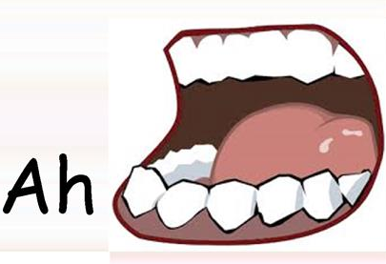
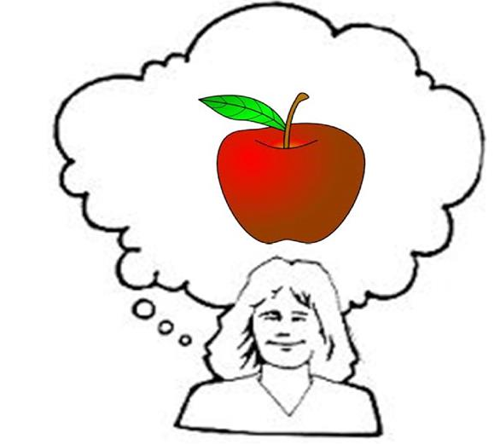
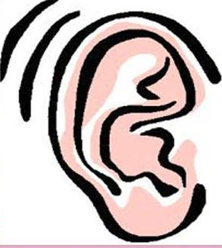
What Is phonics?
Phonics are the alphabet’s sounds.

Slide 5
Why Phonics?
It helps students learn to read.
It helps students to spell words.
It helps students to think in English.
It helps students pronounce English better
It helps students read and understand English better in Junior High School.

Slide 6
Memorization vs. Phonics
Memorization
Students can’t read new words.
They need to see it or write it many times.
They easily forget words if they don’t see it for a long time.
They don’t understand the rules and patterns of pronunciation.
Phonics
Students can read new words on their own.
They can easily spell by listening.
Students can learn alone easily.
Students can develop better interest in English.
More than 500,000 English words can be spelled with Phonics rules.

Slide 7
The Alphabet
The Alphabet has 26 alphabets and each alphabet has “Upper case” or “Capital letters” and “Lower case.”
Each alphabet has a sound. Some alphabets can have 2 or more sounds.

Slide 8
A
B
C
D
E
F
G
H
I
J
K
L
M
N
O
P
Q
R
S
T
U
V
W
X
Y
Z

Slide 9
a
b
c
d
e
f
g
h
i
j
k
l
m
n
o
p
q
r
s
t
u
v
w
x
y
z

Slide 10
Aa
Bb
Cc
Dd
Ee
Ff
Gg
Hh
Ii
Jj
Kk
Ll
Mm
Nn
Oo
Pp
Qq
Rr
Ss
Tt
Uu
Vv
Ww
Xx
Yy
Zz

Slide 11
Alphabet recognition exercises
(Can do for 1st grades to 2nd grades)

Slide 13
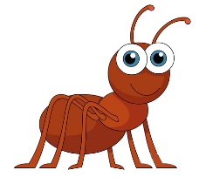
Activity time!
The ant is hungry! Help the ant to the apple! Color all letter Aa.
 |  | B | q | b | A | a | A | p | B
 |  | V | b | a | a | o | a | b | c
O | A | D | a | A | g | v | a | d | p
b | A | a | A | Q | e | D | A | o | b
b | e | g | q | o | a | A | a | v | o
d | A | a | a | A | A | V | P | Q | d
A | a | e | d | o | p | q | e | p | D
a | h | g | A | A | a | b | V | O | q
A | a | A | a | G | a | R | h
q | v | b | g | P | A | a | A

Slide 14
Check your answers!
The ant is hungry! Help the ant to the apple! Color all letter Aa.
 |  | B | q | b | A | a | A | p | B
 |  | C | b | a | a | o | a | b | c
E | A | D | a | A | g | v | a | d | p
b | A | a | A | Q | e | D | A | o | b
b | e | g | q | o | a | A | a | v | o
d | A | a | a | A | A | V | P | Q | d
A | a | e | d | o | p | q | e | p | D
a | h | g | A | A | a | b | V | O | q
A | a | A | a | G | a | R | h
q | v | b | g | P | A | a | A

Slide 15
Phonics song and chants

Slide 17
Phonics awareness
(Can do for 3rd to 4th grades)

Slide 18
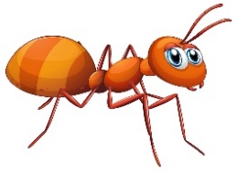
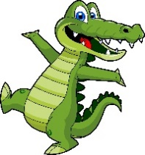
Beginning sounds: Color the letter Aa. Practice the sound by saying Aa says /a/, /a/________.
Aa

Slide 19
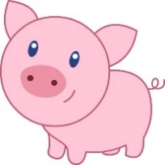
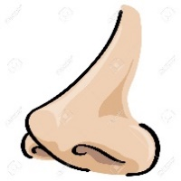
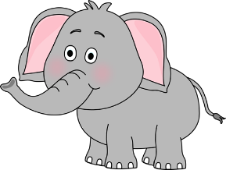
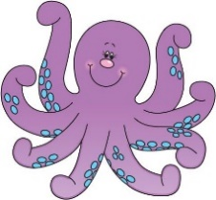
Circle the picture that starts with the letter A.
Aa
Aa

Slide 20
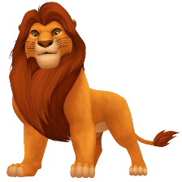
Circle the beginning sound of the picture
 | b
 | p
 | g
 | r
 | z
 | l

